Slide 1
Cluster Randomized Trials
Larry V. Hedges
Northwestern University
Presented at the NSF Institute on Improving the Design of Evaluation studies in STEM Education Research, July 21, 2021

Slide 2
Definition of Cluster Randomized Designs
A cluster randomized design (also called hierarchical design) is that individuals are nested within clusters and entire clusters are randomly assigned to treatment or control conditions
Sample
Intervention
Comparison
Intervention
Cluster 1
Intervention
Cluster 2
…
Intervention
Cluster m
…
Control
Cluster 1
Control
Cluster 2
Control
Cluster m

Slide 3
Definition of Cluster Randomized Designs
An equal number n of individuals from each cluster is typically ideal, but this is not necessary (planning designs almost always assumes equal n per cluster for simplicity)
An equal number of clusters m is typically used in treatment and control groups, but this isn’t necessary either
The key to the design is that clusters are assigned to treatment groups using a random process

Slide 4
Why Would You Use A Cluster Randomized Design?
Cluster randomized designs make sense when it is practically, politically, or conceptually difficult to assign treatments to individuals
For example:
It may be difficult to assign different curricula to students in the same classroom or school
If one treatment is perceived to be more desirable, it may be difficult to persuade parents or students to allow random assignment that could lead to receiving the less desirable treatment
The treatment is defined in terms of whole clusters, it may not be conceptually possible to assign individually (e.g., whole school positive behavior support, whole school or class participation or trust initiatives, etc.)
Cluster randomized designs are also used if there is a high possibility of treatment diffusion within clusters (treatment contamination in the control group), which would compromise the treatment-control contrast

Slide 5
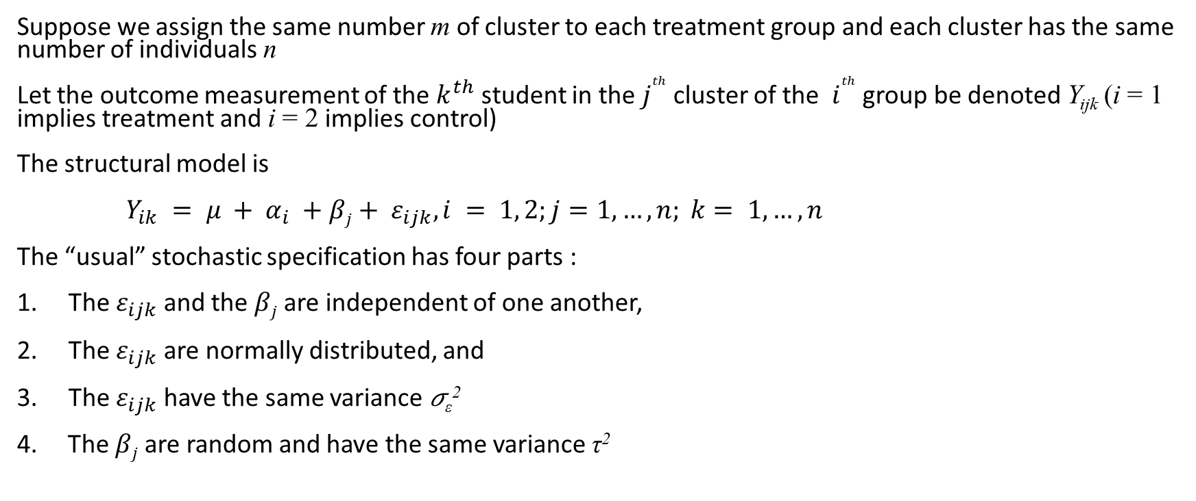
A Statistical Model
Suppose we assign the same number m of cluster to each treatment group and each cluster has the same number of individuals n
Let the outcome measurement of the $k^{th}$ student in the $j^{th}$ cluster of the $i^{th}$ group be denoted Y_{ijk} (i = 1 implies treatment and i = 2 implies control)
The structural model is
$Y_{ik} = μ + α_{i} +βj+ ε_{ijk}, i = 1, 2;j=1, …, n; k= 1, …, n$
The “usual” stochastic specification has four parts :
The $ε_{ijk}$ and the $βj$ are independent of one another,
The $ε_{ijk}$ are normally distributed, and
The $ε_{ijk}$ have the same variance 𝜎_{ε}²
4. The $βj$ are random and have the same variance τ²

Slide 6
The Stochastic Specification
As with other designs, of the four parts of the stochastic specification, only the first part is important
Independence of the observations is crucial but it is empirically unverifiable
We usually think that different individuals, sampled at random from a cluster are independent
We usually think that different clusters, sampled at random from a population are independent
If we can think of the clusters and individuals in our study that way, we may be able to think of them as independent

Slide 7
Effect Size
It is conventional to define the treatment effect size parameter (note the Greek letter δ) in terms of the structural model as the standardized mean difference as
This corresponds the treatment group mean minus the control group mean divided by the within-group standard deviation (sometimes called Cohen’s d)
The treatment effect size is important because:
It is a metric that is widely used to compare treatment effects across different experiments
It is a key factor that determines the sensitivity of research designs

Slide 8
Effect Size
For technical reasons, the mathematically natural effect size in the cluster randomized design does not look the same as that for individually randomized designs, namely (α₁ – α₂)/ 𝜎_{ε}
It is closely related however because the stochastic specification of the model says that the total variance of the outcome is 𝜎_{T}² = 𝜎_{ε}² + τ²
Therefore
where ρ is the intraclass correlation defined by ρ = 𝜎_{ε}²/(𝜎² + τ²)
As it turns out ρ will be small (e.g., ρ < 0.1) in feasible cluster randomized designs for initial field trials so that the “natural” effect size for cluster randomized trials is within 5% of that for individually randomized trials, nearly the same
But, design sensitivity for cluster randomized designs is lower than that of individually randomized designs for other reasons

Slide 9
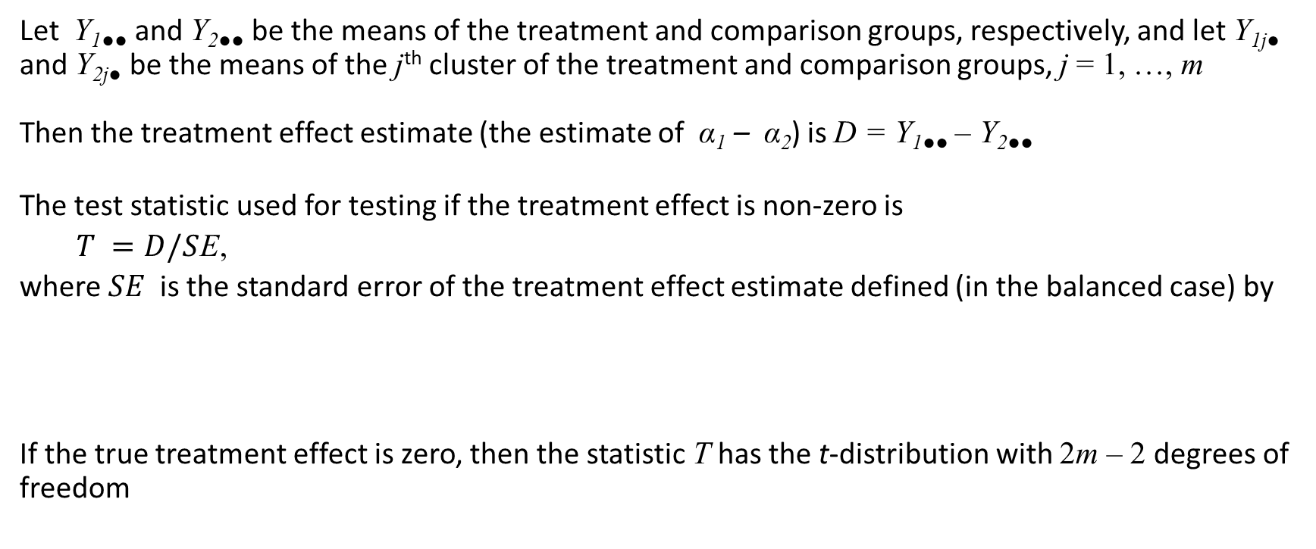
Testing the Significance of the Treatment Effect
Let Y_{1●●} and Y_{2●●} be the means of the treatment and comparison groups, respectively, and let Y_{1j●} and Y_{2j●} be the means of the j^{th} cluster of the treatment and comparison groups, j = 1, …, m
Then the treatment effect estimate (the estimate of α₁ – α₂) is D = Y_{1●●} – Y_{2●●}
The test statistic used for testing if the treatment effect is non-zero is
$T =D/S$E,
where $SE$is the standard error of the treatment effect estimate defined (in the balanced case) by
If the true treatment effect is zero, then the statistic T has the t-distribution with 2m – 2 degrees of freedom

Slide 10
Testing the Significance of the Treatment Effect
The significance testing process involves
Picking a significance level (this is up to you, but 0.05 is conventional)
Computing the value of T from the data
Obtaining the critical value of the t-distribution with 2m – 2 degrees of freedom (which will be about 2 for the for all but the smallest degrees of freedom)
Reject the null hypothesis of no treatment effect (in other words conclude that the treatment effect is significant) if |T| exceeds the critical value
You could also use software that computes the “exact p-value.” In that method, conclude that the treatment effect is significant if the two-tailed p-value is less than 0.05

Slide 11
Déjà vu?
You might be thinking you have seen this test statistic and testing procedure before somewhere
You have: This looks a lot like the test statistic for the individually randomized design
It turns out that when the design is balanced (all clusters have the same size n) the optimal significance test in the cluster randomized design is just the same as treating the cluster means (the Y_{1j●}‘s and Y_{2j●} ‘s as if they were “individual observations,” so there are 2m “observations”
If the design is almost balanced just analyzing the cluster means would be very close to optimal
Many people seem to feel that it is much better to analyze all the data (not just the cluster means), but this is wrong because of the statistical principle of sufficiency: Sometimes summary statistics (like cluster means) contain all the information in the observations and any sensible analysis depends on the data only through those summary statistics
Y_{1j●}
Y_{1j●}
Y_{1j●}

Slide 12
Design Sensitivity
Recall that design sensitivity can be described in any one of three related ways:
Statistical power
Precision (standard error) of the estimated treatment effect
The minimum detectable effect size (MDES)
We will discuss design sensitivity mainly through MDES
As a practical matter, design sensitivity for cluster randomized designs is limited primarily by the number of clusters (m), and that clusters will often be schools (but sometimes classrooms)
We assume in this workshop that the number of schools available is limited to 5 – 10 , rarely as many as 20, so that m = 5 – 10 is about the maximum number of clusters that are feasible
If clusters are classrooms, a slightly larger number might be feasible

Slide 13
MDES in Cluster Randomized Designs
In cluster randomized designs, MDES depends on
1. The significance level (0.05 is a very strong convention)
2. The power level desired (0.8 is a strong convention)
The number m of clusters randomized to each treatment
The number of individuals n within each cluster
The intraclass correlation ρ (this is a new and complicating factor in cluster randomized designs)
The covariate outcome correlation R is covariates are used

Slide 14
MDES in Cluster Randomized Designs
MDES in cluster randomized designs depends strongly on the number m of clusters
MDES in cluster randomized designs depends weakly on the number n of individuals in each cluster
Moreover, there is a point of diminishing returns in increasing n, MDES decreases less rapidly until it reaches an asymptote
MDES tends to some positive value even when n → ∞
Thus, total sample size n = 2mn is a poor guide to design sensitivity
But remember that design sensitivity also depends on ρ, so understanding MDES in cluster randomized designs is a complex business

Slide 15
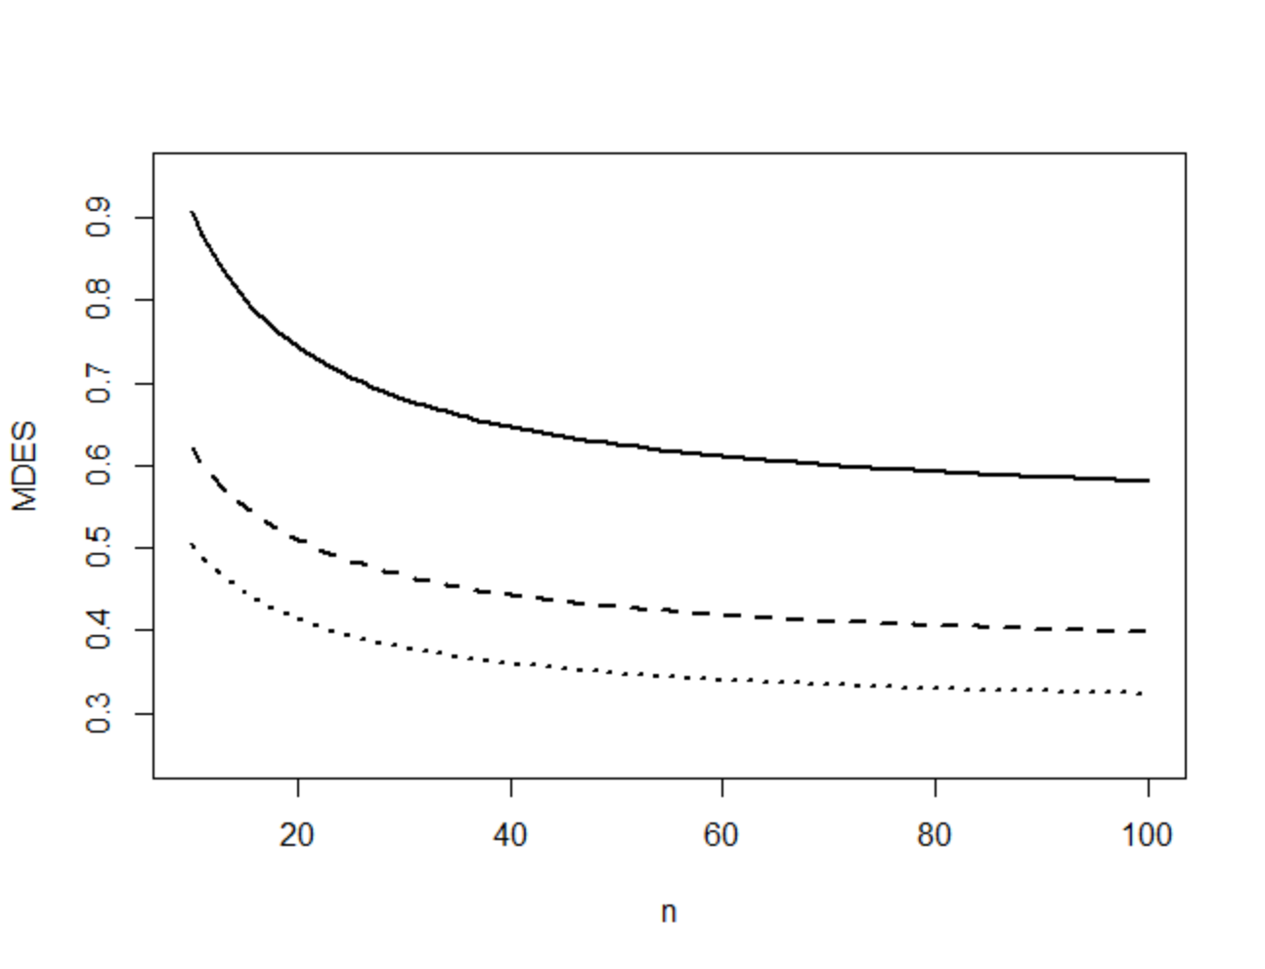
A Graphical Representation of MDES as Function of n
All figures have ρ = 0.05
m = 4 (solid line)
m = 7 (dashed line)
m = 10 (dotted line)

Slide 16
MDES as a Function of m and n for ρ = 0.05
 | n
m | 10 | 15 | 20 | 25 | 50 | 75 | 100 | 200 | 500 | ∞
2 | 2.15 | 1.90 | 1.77 | 1.68 | 1.49 | 1.42 | 1.38 | 1.32 | 1.29 | 1.27
3 | 1.17 | 1.03 | 0.96 | 0.91 | 0.81 | 0.77 | 0.75 | 0.72 | 0.70 | 0.69
4 | 0.91 | 0.80 | 0.74 | 0.71 | 0.63 | 0.60 | 0.58 | 0.56 | 0.54 | 0.53
5 | 0.77 | 0.68 | 0.63 | 0.60 | 0.53 | 0.51 | 0.49 | 0.47 | 0.46 | 0.45
6 | 0.68 | 0.60 | 0.56 | 0.53 | 0.47 | 0.45 | 0.44 | 0.42 | 0.41 | 0.40
7 | 0.62 | 0.55 | 0.51 | 0.48 | 0.43 | 0.41 | 0.40 | 0.38 | 0.37 | 0.36
8 | 0.57 | 0.51 | 0.47 | 0.45 | 0.40 | 0.38 | 0.37 | 0.35 | 0.34 | 0.34
9 | 0.54 | 0.47 | 0.44 | 0.42 | 0.37 | 0.35 | 0.34 | 0.33 | 0.32 | 0.32
10 | 0.50 | 0.45 | 0.41 | 0.39 | 0.35 | 0.33 | 0.32 | 0.31 | 0.30 | 0.30
11 | 0.48 | 0.42 | 0.39 | 0.37 | 0.33 | 0.32 | 0.31 | 0.29 | 0.29 | 0.28
12 | 0.46 | 0.40 | 0.37 | 0.36 | 0.32 | 0.30 | 0.29 | 0.28 | 0.27 | 0.27
13 | 0.44 | 0.39 | 0.36 | 0.34 | 0.30 | 0.29 | 0.28 | 0.27 | 0.26 | 0.26
14 | 0.42 | 0.37 | 0.34 | 0.33 | 0.29 | 0.28 | 0.27 | 0.26 | 0.25 | 0.25
15 | 0.40 | 0.36 | 0.33 | 0.32 | 0.28 | 0.27 | 0.26 | 0.25 | 0.24 | 0.24

Slide 17
MDES in Cluster Randomized Designs Depends on ρ
The dependence of design sensitivity on ρ may seem puzzling, but it comes from the nature of two stage sampling
Recall the design effect idea. The cluster randomized design involves a two-stage cluster sample. The fact that it is a cluster sample imposes a design effect involving ρ
One way of talking about this is that ρ (along with n) determines the “effective sample size”
The effective sample size is somewhere between the number of clusters 2m and the total sample size 2mn, determined by the values of ρ and n
Effective sample size is

Slide 18
Asymptotic MDES (as n→∞) as a Function of m and ρ
 | Intraclass correlation ρ
m | 0.01 | 0.02 | 0.03 | 0.04 | 0.05 | 0.06 | 0.07 | 0.08 | 0.09 | 0.10 | 1.0
2 | 0.57 | 0.80 | 0.98 | 1.13 | 1.27 | 1.38 | 1.50 | 1.60 | 1.70 | 1.79 | 5.65
3 | 0.31 | 0.43 | 0.53 | 0.61 | 0.69 | 0.75 | 0.81 | 0.87 | 0.92 | 0.97 | 3.10
4 | 0.24 | 0.34 | 0.41 | 0.48 | 0.53 | 0.58 | 0.63 | 0.67 | 0.71 | 0.75 | 2.40
5 | 0.20 | 0.29 | 0.35 | 0.40 | 0.45 | 0.50 | 0.54 | 0.57 | 0.61 | 0.64 | 2.00
6 | 0.18 | 0.25 | 0.31 | 0.36 | 0.40 | 0.44 | 0.48 | 0.51 | 0.54 | 0.57 | 1.80
7 | 0.16 | 0.23 | 0.28 | 0.33 | 0.36 | 0.40 | 0.43 | 0.46 | 0.49 | 0.52 | 1.60
8 | 0.15 | 0.21 | 0.26 | 0.30 | 0.34 | 0.37 | 0.40 | 0.43 | 0.45 | 0.48 | 1.50
9 | 0.14 | 0.20 | 0.24 | 0.28 | 0.32 | 0.34 | 0.37 | 0.40 | 0.42 | 0.44 | 1.40
10 | 0.13 | 0.19 | 0.23 | 0.26 | 0.30 | 0.32 | 0.35 | 0.38 | 0.40 | 0.42 | 1.30
11 | 0.13 | 0.18 | 0.22 | 0.25 | 0.28 | 0.31 | 0.33 | 0.36 | 0.38 | 0.40 | 1.30
12 | 0.12 | 0.17 | 0.21 | 0.24 | 0.27 | 0.29 | 0.32 | 0.34 | 0.36 | 0.38 | 1.20
13 | 0.12 | 0.16 | 0.20 | 0.23 | 0.26 | 0.28 | 0.30 | 0.32 | 0.34 | 0.36 | 1.10
14 | 0.11 | 0.16 | 0.19 | 0.22 | 0.25 | 0.27 | 0.29 | 0.31 | 0.33 | 0.35 | 1.10
15 | 0.11 | 0.15 | 0.18 | 0.21 | 0.24 | 0.26 | 0.28 | 0.30 | 0.32 | 0.34 | 1.10

Slide 19
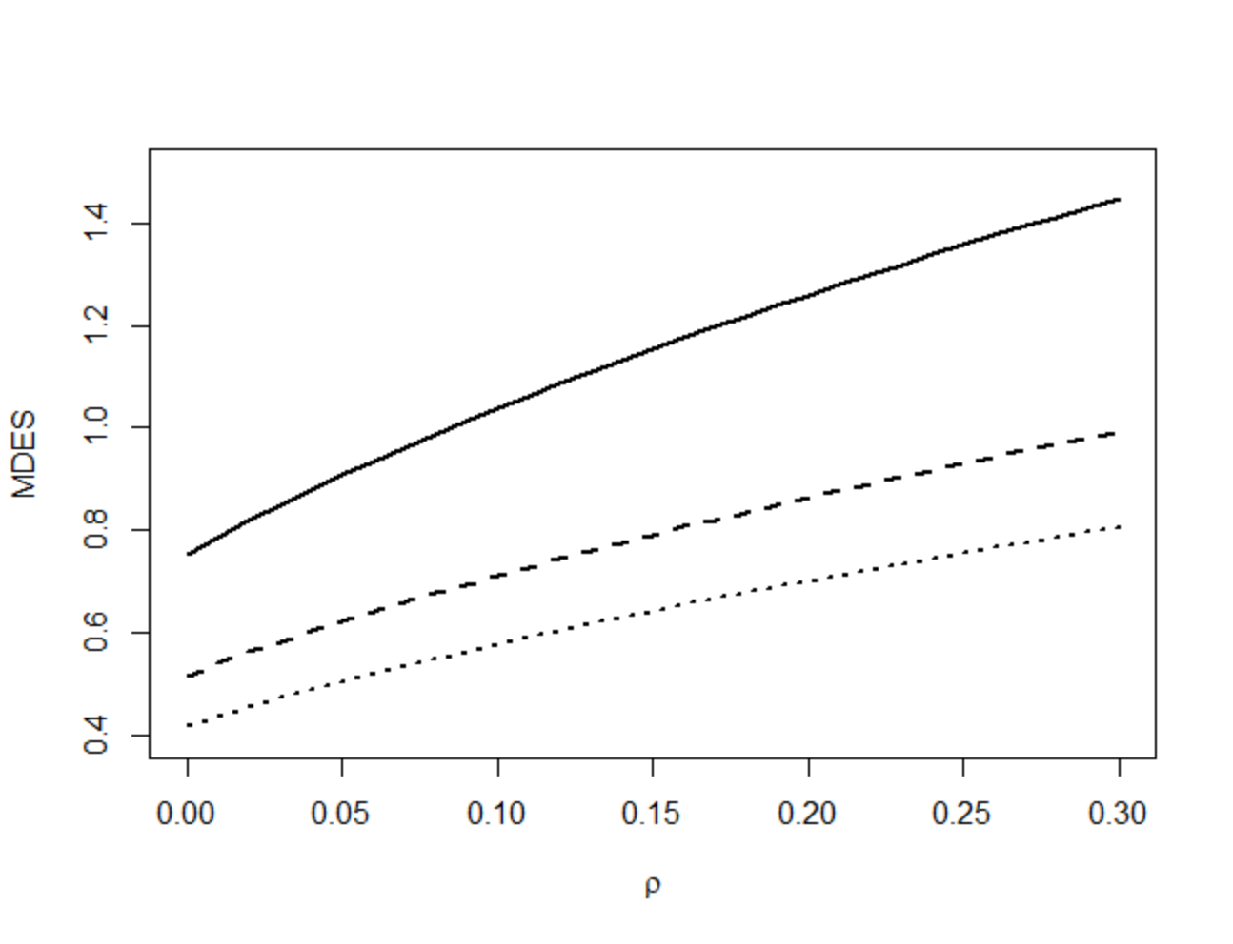
A Graphical Representation of MDES as a Function of ρ
All figures have n = 10
m = 4 (solid line)
m = 7 (dashed line)
m = 10 (dotted line)

Slide 20
The Fundamental Problem of Research Design
The fundamental problem of research design is how to plan a feasible design that is adequately sensitive
If you have unlimited number of clusters, it is easy to get any design sensitivity you want
But we usually have a severely limited number of clusters (m = 5 – 10)
In the easiest case, then you simply use a table like the one presented previously or a software tool and find the m for your n and ρ that has an MDES that is smaller than the effect size you expect
Often, that number m of clusters is larger than the sample you believe you could get
What then?

Slide 21
Three Strategies to Improve Design Sensitivity
Three strategies can be used to improve design sensitivity:
Matching clusters before random assignment (this strategy should probably always be used in initial field trials)
Increase cluster size
Use of covariates
Unbalanced designs using control clusters than treatment clusters

Slide 22
Matching of Clusters Before Random Assignment
The sensitivity of cluster randomized designs can be increased substantially by matching clusters before random assignment
If a covariate is available (pretest scores of last year’s achievement test scores) it is possible to “tailor” clusters so that they match very closely on the covariate
Tailoring would involve dropping individuals from clusters (from the experiment not literally removing them) so that the covariate scores on the clusters are close to identical
Because the intraclass correlation is measured on the outcome, this will not make the intraclass correlation zero even if the average covariate scores match exactly
But matching on the covariate will make the intraclass correlation small: If the covariate-outcome correlation is 0.7, this can make the intraclass correlation ρ < 0.05

Slide 23
Increase Cluster Size
If clusters are schools, it may be possible to increase the cluster size (more students per school) than to increase the number of clusters
Particularly if the intraclass correlation is small, we saw that increasing cluster size (up to a point) will increase design sensitivity

Slide 24
Adding Covariates
A covariate is any variable whose value cannot be influenced by treatment assignment
Useful covariates are those that are correlated with the outcome
A pretest covering similar content is often a good covariate
The covariate does not need to measure the same things to be useful: All that matters is that it is correlated with the outcome
You do not need to have a theory of why the covariate is correlated with the outcome
Reading scores can be useful covariates for math and science outcomes and vice versa
Demographic variables (gender, ethnicity, SES) tend to be less useful as covariates than test scores
Note: If you matched clusters before random assignment, covariates will be less effective in increasing design sensitivity because matching reduces the covariate-outcome correlation at the cluster level

Slide 25
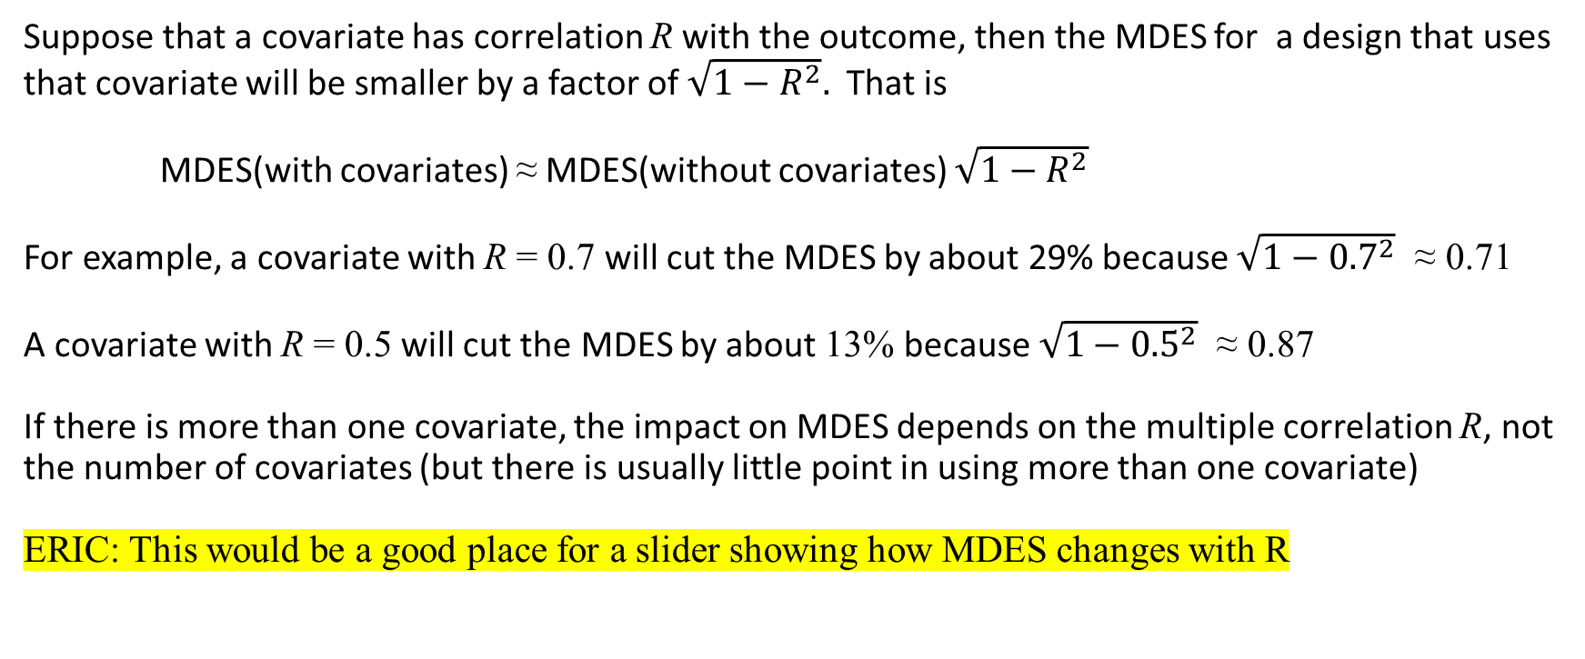
The Effect of Covariates on MDES
Suppose that a covariate has correlation R with the outcome, then the MDES for a design that uses that covariate will be smaller by a factor of $\sqrt{1−R^{2}}.$ That is
MDES(with covariates) ≈ MDES(without covariates) $\sqrt{1−R^{2}}$
For example, a covariate with R = 0.7 will cut the MDES by about 29% because $\sqrt{1−{0.7}^{2}}$ ≈ 0.71
A covariate with R = 0.5 will cut the MDES by about 13% because $\sqrt{1−{0.5}^{2}}$ ≈ 0.87
If there is more than one covariate, the impact on MDES depends on the multiple correlation R, not the number of covariates (but there is usually little point in using more than one covariate)
ERIC: This would be a good place for a slider showing how MDES changes with R

Slide 26
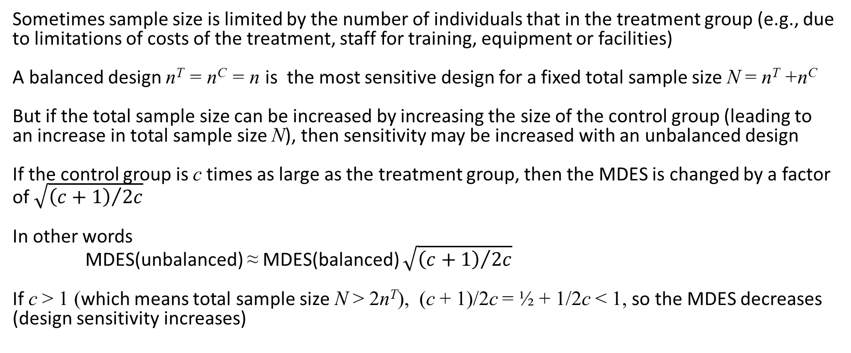
Unbalanced Designs
Sometimes sample size is limited by the number of individuals that in the treatment group (e.g., due to limitations of costs of the treatment, staff for training, equipment or facilities)
A balanced design n^{T} = n^{C} = n is the most sensitive design for a fixed total sample size N = n^{T} +n^{C}
But if the total sample size can be increased by increasing the size of the control group (leading to an increase in total sample size N), then sensitivity may be increased with an unbalanced design
If the control group is c times as large as the treatment group, then the MDES is changed by a factor of $\sqrt{{\left(c+1\right)}/{2c}}$
In other words
MDES(unbalanced) ≈ MDES(balanced) $\sqrt{{\left(c+1\right)}/{2c}}$
If c > 1 (which means total sample size N > 2n^{T}), (c + 1)/2c = ½ + 1/2c < 1, so the MDES decreases (design sensitivity increases)

Slide 27
Unbalanced Designs
Eric: This would be a good place for an insert of how increasing m^{C} (fixing m^{T}) deceases MDES
Note that the effect on MDES (design sensitivity) of increasing sample size of the control group are generally modest (except for the smallest treatment group sample sizes
Note that there is a point of diminishing returns, beyond which further increases have only negligible effects

Slide 28
The Effect on MDES of Larger Control Groups
 | m^{C}
m^{T} | m^{T}+0 | m^{T}+1 | m^{T}+2 | m^{T}+3 | m^{T}+4 | m^{T}+5 | m^{T}+10 | m^{T}+15
2 | 1.49 | 1.02 | 0.86 | 0.77 | 0.72 | 0.69 | 0.61 | 0.58
3 | 0.81 | 0.71 | 0.65 | 0.61 | 0.58 | 0.56 | 0.51 | 0.48
4 | 0.63 | 0.58 | 0.54 | 0.52 | 0.50 | 0.49 | 0.45 | 0.43
5 | 0.53 | 0.50 | 0.48 | 0.46 | 0.45 | 0.44 | 0.40 | 0.39
6 | 0.47 | 0.45 | 0.43 | 0.42 | 0.41 | 0.40 | 0.37 | 0.36
7 | 0.43 | 0.41 | 0.40 | 0.39 | 0.38 | 0.37 | 0.35 | 0.33
8 | 0.40 | 0.38 | 0.37 | 0.36 | 0.36 | 0.35 | 0.33 | 0.31
9 | 0.37 | 0.36 | 0.35 | 0.34 | 0.34 | 0.33 | 0.31 | 0.30
10 | 0.35 | 0.34 | 0.33 | 0.33 | 0.32 | 0.31 | 0.30 | 0.28
11 | 0.33 | 0.32 | 0.32 | 0.31 | 0.31 | 0.30 | 0.28 | 0.27
12 | 0.32 | 0.31 | 0.30 | 0.30 | 0.29 | 0.29 | 0.27 | 0.26
13 | 0.30 | 0.30 | 0.29 | 0.29 | 0.28 | 0.28 | 0.26 | 0.25
14 | 0.29 | 0.28 | 0.28 | 0.28 | 0.27 | 0.27 | 0.26 | 0.25
15 | 0.28 | 0.27 | 0.27 | 0.27 | 0.26 | 0.26 | 0.25 | 0.24

Slide 29
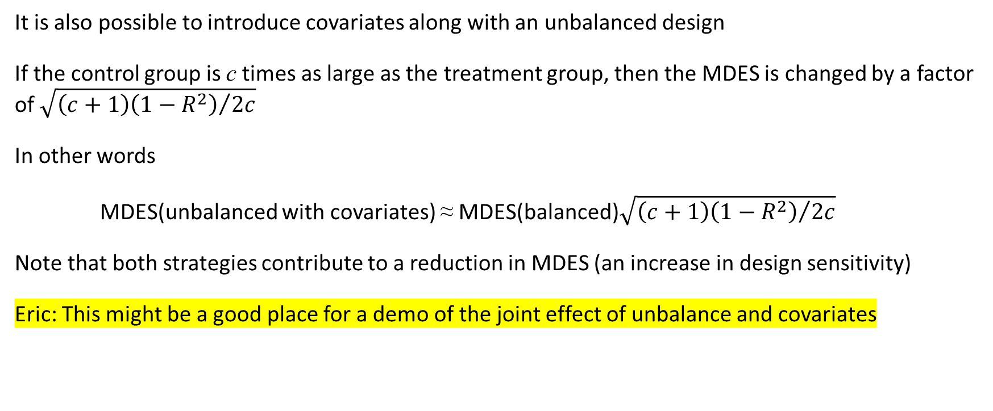
You Can Use Both Covariates and Imbalance (and maybe larger cluster sizes)
It is also possible to introduce covariates along with an unbalanced design
If the control group is c times as large as the treatment group, then the MDES is changed by a factor of $\sqrt{{\left(c+1\right)\left(1−R^{2}\right)}/{2c}}$
In other words
MDES(unbalanced with covariates) ≈ MDES(balanced)$\sqrt{{\left(c+1\right)\left(1−R^{2}\right)}/{2c}}$
Note that both strategies contribute to a reduction in MDES (an increase in design sensitivity)
Eric: This might be a good place for a demo of the joint effect of unbalance and covariates

